Slide 1
Does region of the country affect health outcomes?
Team 7
Ryan Dekker
Andrea Hernandez
Daniela Trujillo

Slide 2
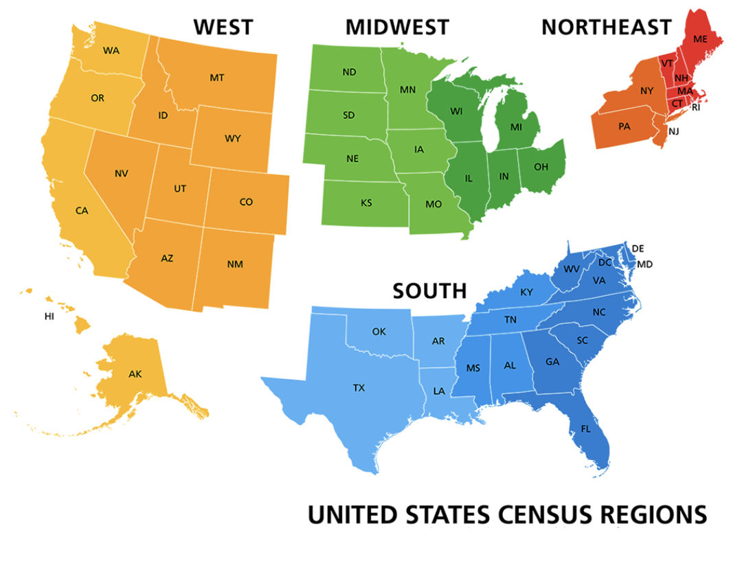
This is an Exploratory Data Analysis (EDA) Project focusing on an a major concern in community Healthcare.
For each region we explore:
Gender
General Health
Smoking Status
Alcohol Use
Teeth Removal
This exploration aims to understand which factors are more prevalent when predicting heart attack or stroke.
*The U.S. Census designates 4 official regions
Using these medical data, does the region in which a patient lives play a part in predicting their risk of suffering from a heart attack or stroke?

Slide 3


Brief background on data
This dataset, “Indicators of Heart Disease (2022 Update)” (hosted by kaggle) is a CDC sample of 240,141 patients from 2022
Contains categorical demographic (gender, ethnicity) data
and health measurements (weight, BMI, physical activity, smoking stats, etc.)
Patient info serves as the independent variables for the dependent variables of heart attack and stroke
Because all 50 states were present, we coded the data into the four official regions to see if different regions had different health outcomes
Notes:
This dataset provides a plethora of factors that can potentially impact heart disease from gender and ethnicity to depression and number of hours of sleep each patient got each night. Our goal was to first split this data into the four regions, then focus on only a few factors to understand exactly how region impacts the heart health of a patient. We then used numpy, scipy, and matplotlib python coding in jupyter notebook to perform our analysis.

Slide 4
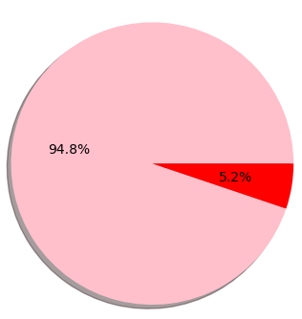
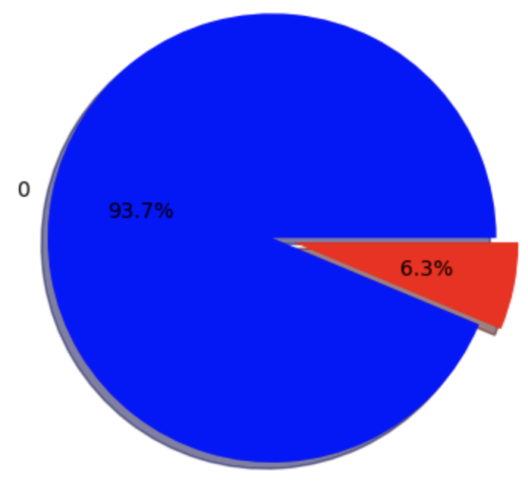
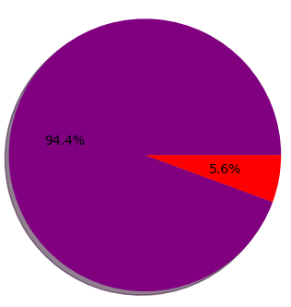
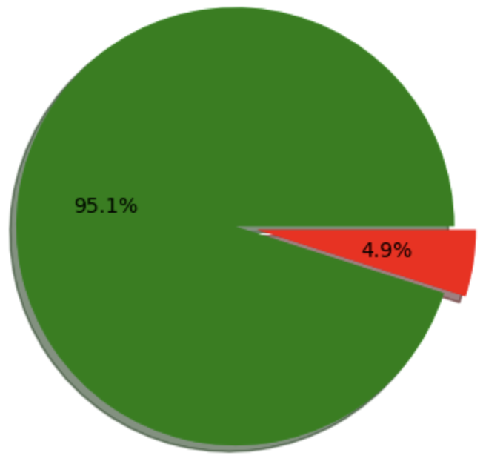
Rate of heart attack per region
Northeast | South
5.2% had Heart attack | 6.3% had heart attack
Midwest | West
5.6% had Heart attack | 4.9% had heart attack
Notes:
One of the first aspects of this eda project was looking at the breakdown of how many patients surveyed had already suffered from a heart attack by region. We used a pie chart for each region to show the percentage of those that had a heart attack and those that did not. Those that did suffer from a heart attack are in red for each region, with the south having the highest percentage of 6.3% of patients surveyed did indeed have a heart attack

Slide 5
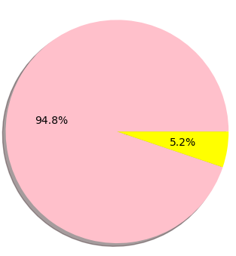
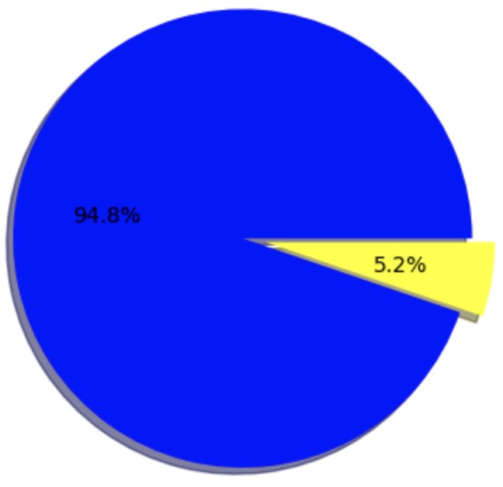
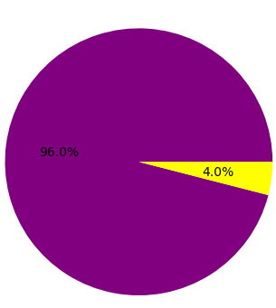
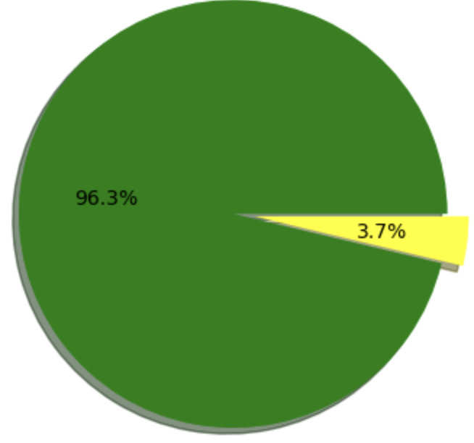
Rate of stroke per region
Northeast | South
5.2% had stroke | 5.2% had stroke
Midwest | West
4.0% had stroke | 3.7% had stroke
Notes:
In this slide we performed the same analysis on patients that had suffered from a stroke (percentage in yellow) and here we see that both the Northeast and the South have the highest percentage of patients that suffered from a stroke.

Slide 6
Analyzing results for heart attacks and stroke
Among the four regions, rate of heart attacks did show significant differences
For example, if the South had a 6.3% rate and the West had a 4.9% rate, then the U.S. South has a 28.6% higher rate of heart attacks comparatively than the West.
For stroke, less of a regional difference existed
All regions were between 4 - 5%
Notes:
This analysis indicates that there are indeed factors that influence the rate of heart attack and stroke depending on what region of the United states you live in. We started our analysis by focusing on the prevalence of heart attack and stroke between men and women in each region

Slide 7
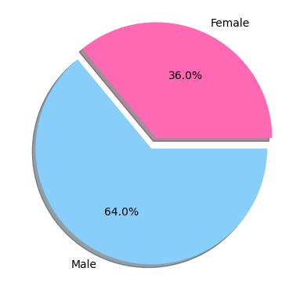
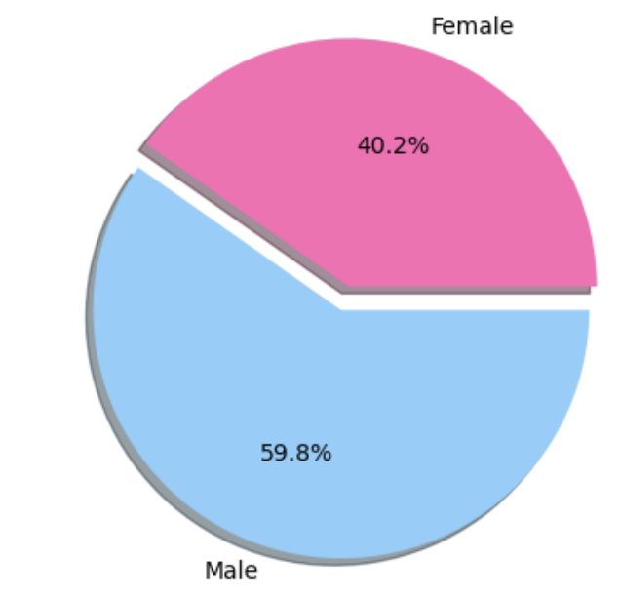
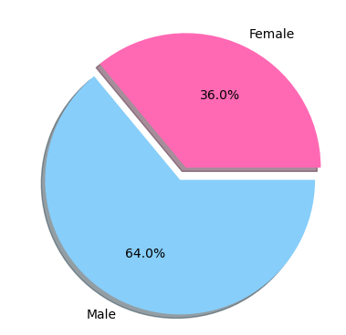
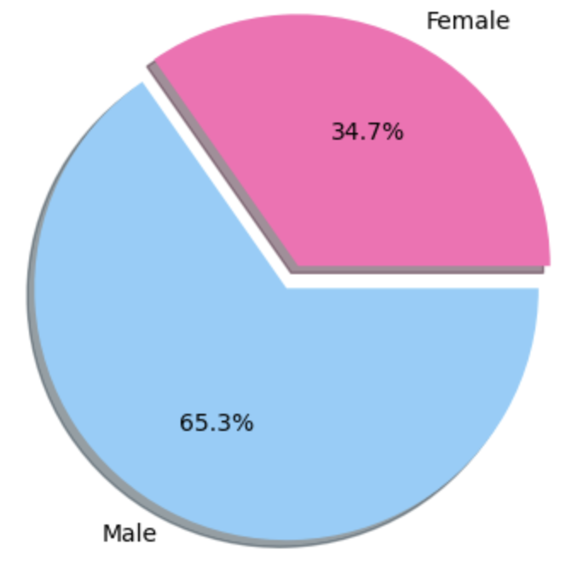
Gender as a predictor of heart attacks
Northeast | South
Of those who had a heart attack, 45% were men and 65% were women | Of those who had a heart attack, 60% were men and 40% were women
Midwest | West
Of those who had a heart attack, 35% were men and 65% were women | Of those who had a heart attack, 65% were men and 35% were women

Slide 8
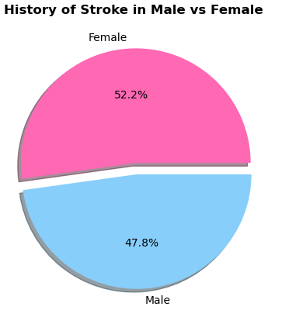
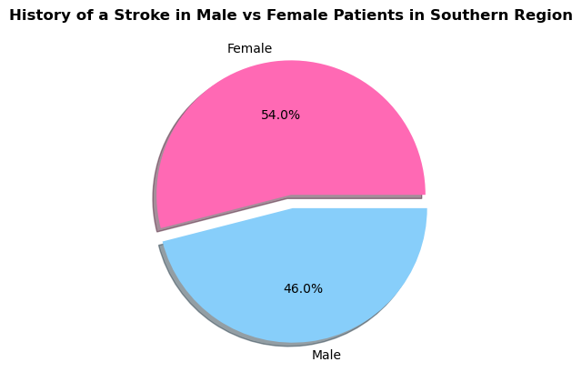
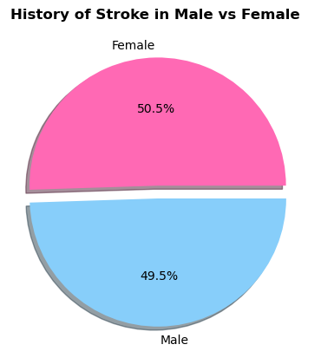
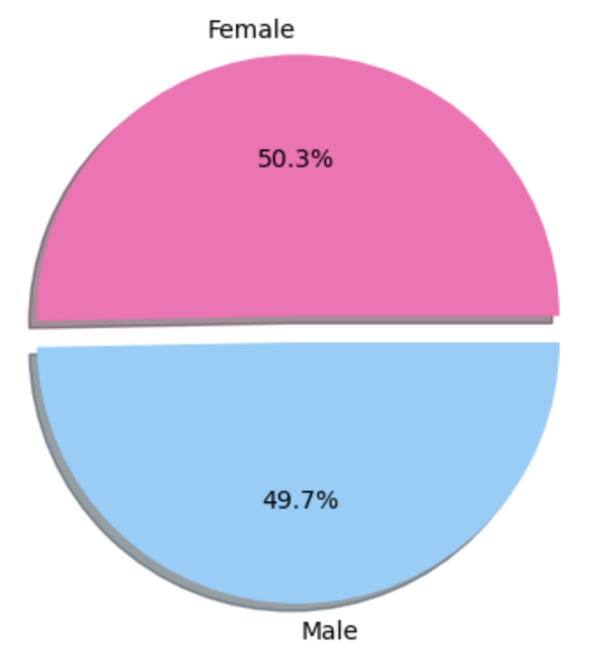
Gender as a predictor of stroke
Northeast | South
Of those who had a stroke, 52% were Women and 48% Were men | Of those who had a stroke, 54% were Women and 46% men
Midwest | West - had stroke
Of those who had a stroke, 51% were Woman and 49% Were men | Of those who had a stroke, there was a 50-50 split

Slide 9
Analyzing gender as a predictor using p-values
Using a t-test for the West region, the probability of gender factoring only by chance was (very!) small…
p = 0.000000000000000000000000000000000000000000000000000000005259477264381248
But gender as a predictor for stroke was almost entirely chance.
p = 0.92
Overall, men were clearly more likely to have heart attacks than women, while women were more likely to have had a stroke…
… but the ‘gender effect’ for stroke is far from conclusive
Notes:
South Gender heartattack: TtestResult(statistic=-16.668701635129242, pvalue=3.1556670886651587e-62,
South Gender stroke: TtestResult(statistic=0.08393648861519239, pvalue=0.9331072357494374

Slide 10
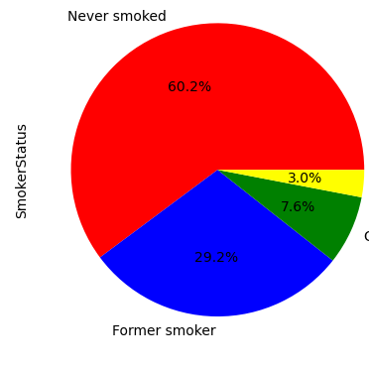
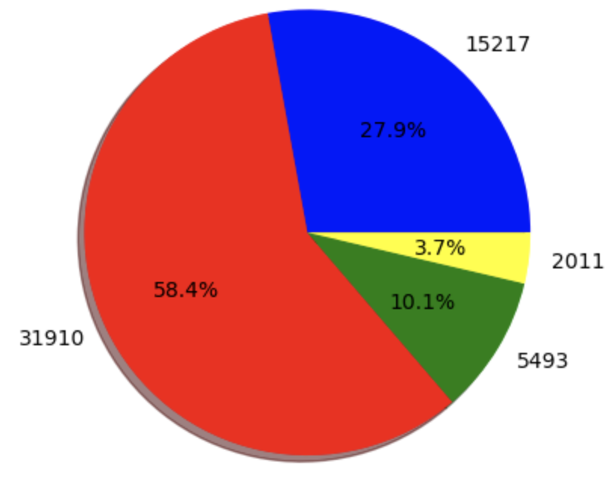
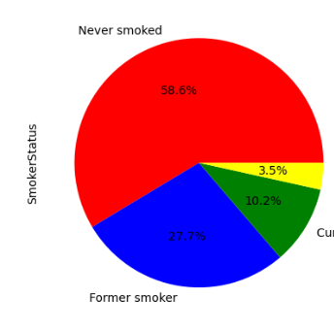
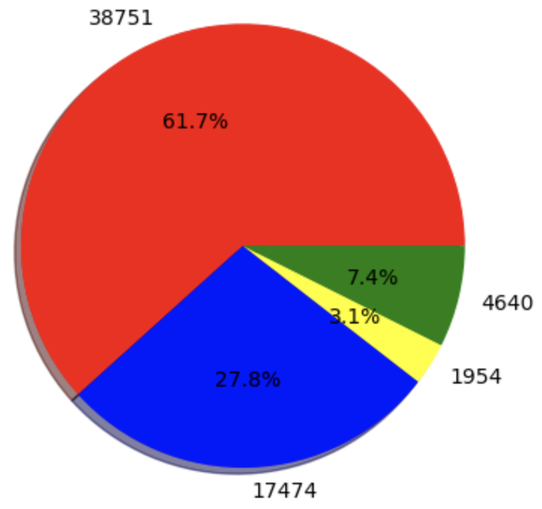
Comparing smoking status per region
Northeast | South
60% never smoke; 8% smoke every day | 58% never smoked; 10% smoke every day
Midwest | West
59% never smoke; 10% smoke every day | 62% never smoked; 7% smoke every day
= never smoked
= former smoker
= smoke every day
= smoke some days

Slide 11
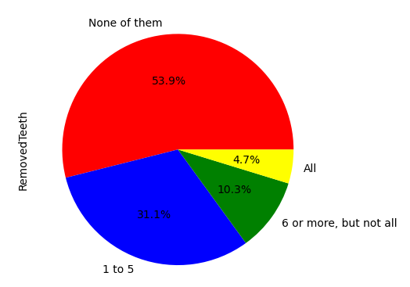
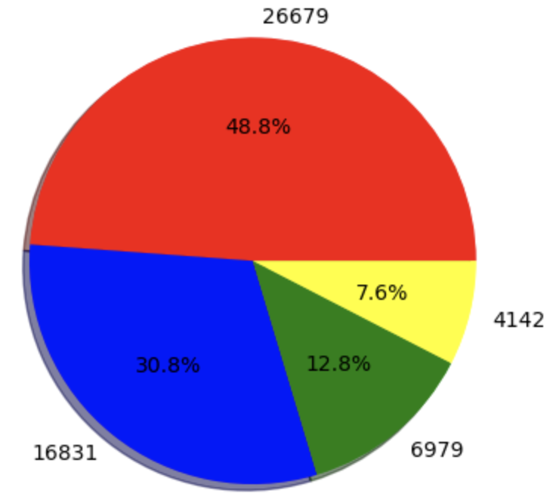
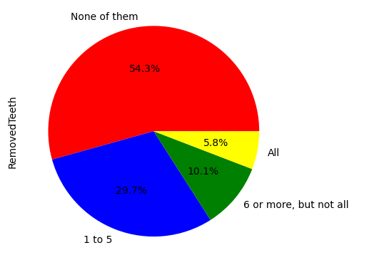
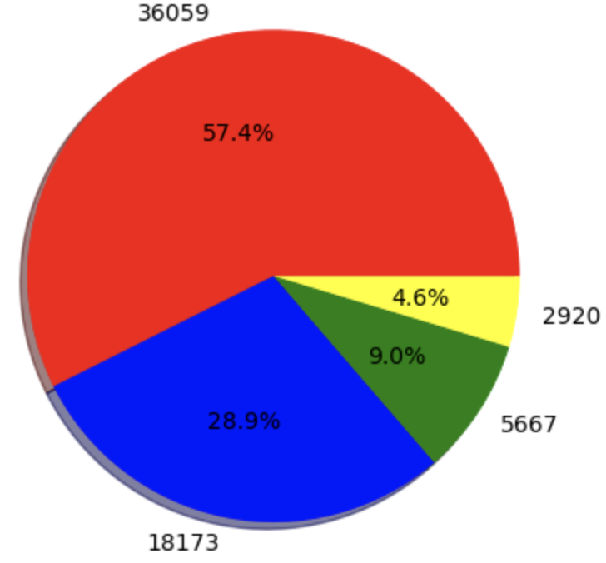
Pie charts per region of removed teeth
Northeast | South
54% never had Teeth removed | 49% never had teeth removed
Midwest | West
54% never had Teeth removed | 57% never had teeth removed
= none
= 1-5
= 6+ (but not all)
= all

Slide 12
Heart attack factors
Smoking and having teeth pulled have clear correlations for predicting heart attacks.
Alcohol drinking showed very mixed results
Region | Heart attack rate | % Never smoked | % had teeth pulled | % Alcohol drinkers
South | 6.3% | 58% | 51% | 49%
Midwest | 5.4% | 59% | 46% | 57%
Northeast | 5.2% | 60% | 46% | 60%
West | 4.9% | 62% | 43% | 55%

Slide 13
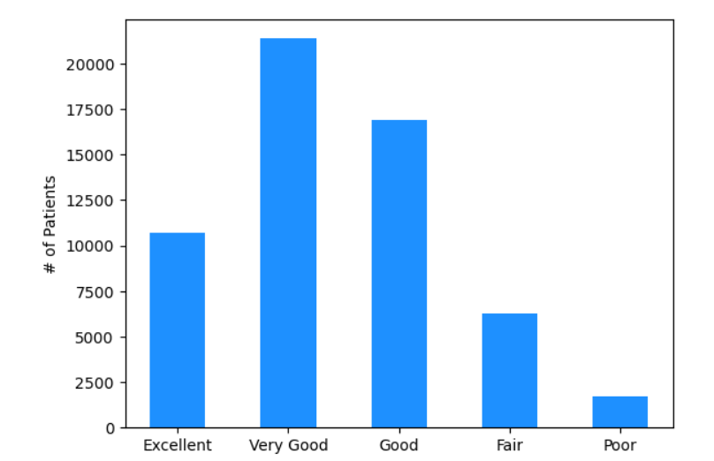
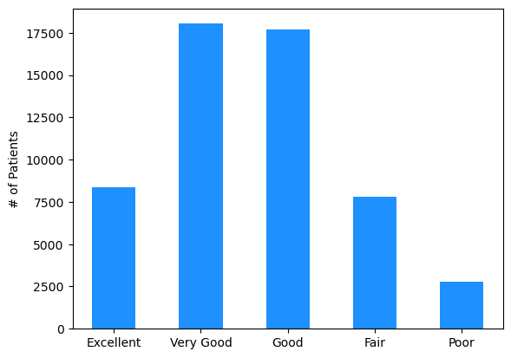
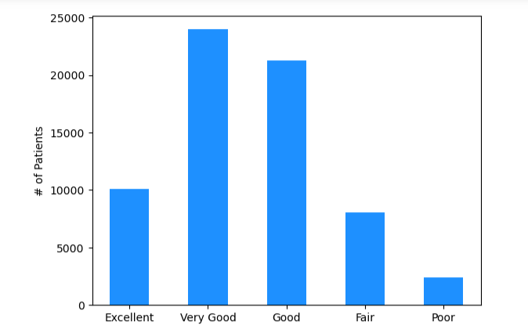
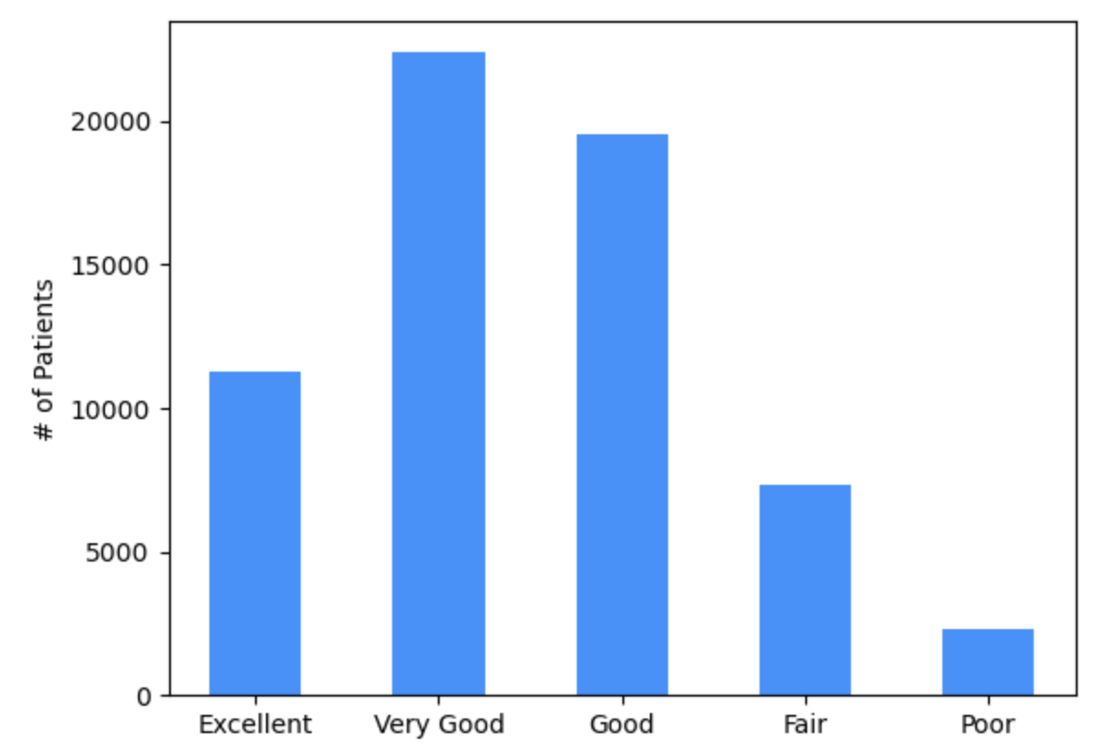
Bar graphs per region of general health
(ranging from ‘excellent’ to ‘poor’)
Northeast | South -
Midwest | West

Slide 14


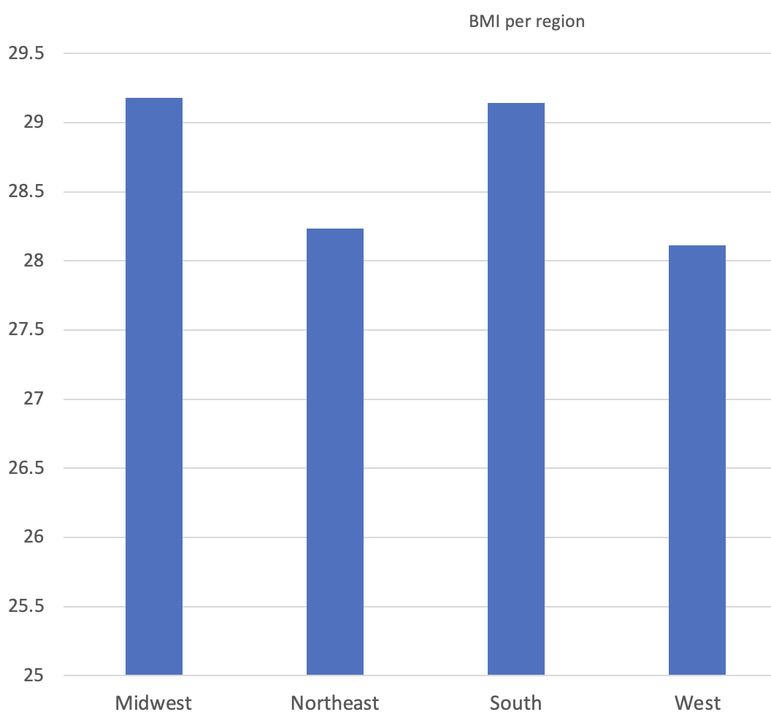
Region and BMI
The South (29.1) and Midwest (29.2) pattern together
As do the West (28.1) and the Northeast (28.2)

Slide 15
Analysis of general health and region
The order of BMI didn’t precisely predict the order for heart attack, as the Midwest (narrowly) had the highest score, but the Midwest did not have the highest rate of heart attacks
Once again, comparing the South to the West…
South has a higher rate for general health of ‘Poor’ and the West has a higher rate of ‘Good’

Slide 16
Conclusions
Regional differences existed for heart attack and stroke, but much stronger for heart attack
The South had the highest rate of both; the West always had the lowest rate
These differences were caused, in part, by differences in health measurements, as patterns were found for general health, BMI, and smoking status
Generally not for alcohol consumption
**Regional differences in lifestyle predict different health outcomes.**

Slide 17
Limitations of the dataset
While the raw numbers are large, this is still only just a sample
Some states may be overrepresented or underrepresented
These data do not show economic factors that may cause the lifestyle differences that caused different health outcomes
Additionally, there was nothing in the data about diet, which could differ from region to region and help explain different health outcomes
Finally, there were many other demographic data we did not have time to explore…

Slide 18
Questions?

Slide 19
References
Dataset link -
https://www.kaggle.com/datasets/kamilpytlak/personal-key-indicators-of-heart-disease/
This dataset was added to Kaggle by Kamil Pytlak and has a CC0:Public Domain License and has been used for many EDA projects.

